Slide 1

7
The MS-DOS Interface

Slide 2

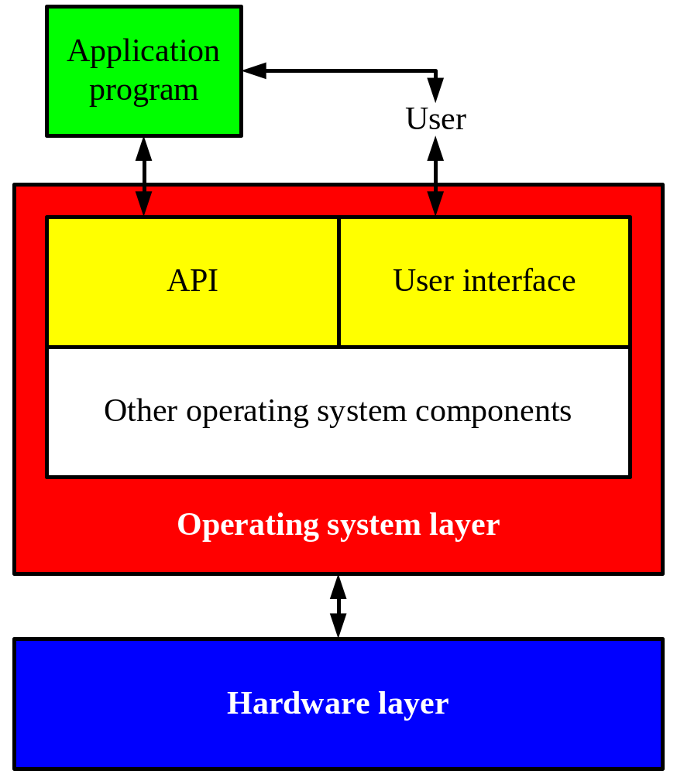
Figure 7.1 A user communicates with the operating system through a user interface.

Slide 3
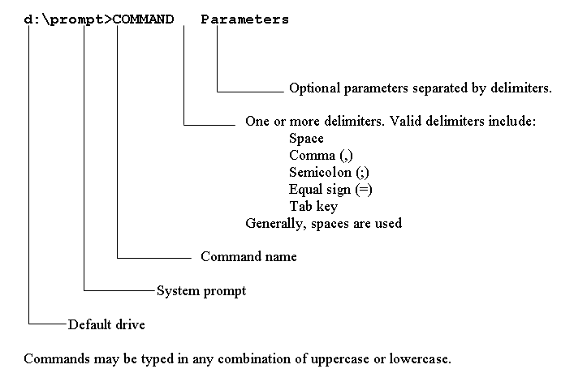
Figure 7.2 The general form of an MS-DOS command.

Slide 4
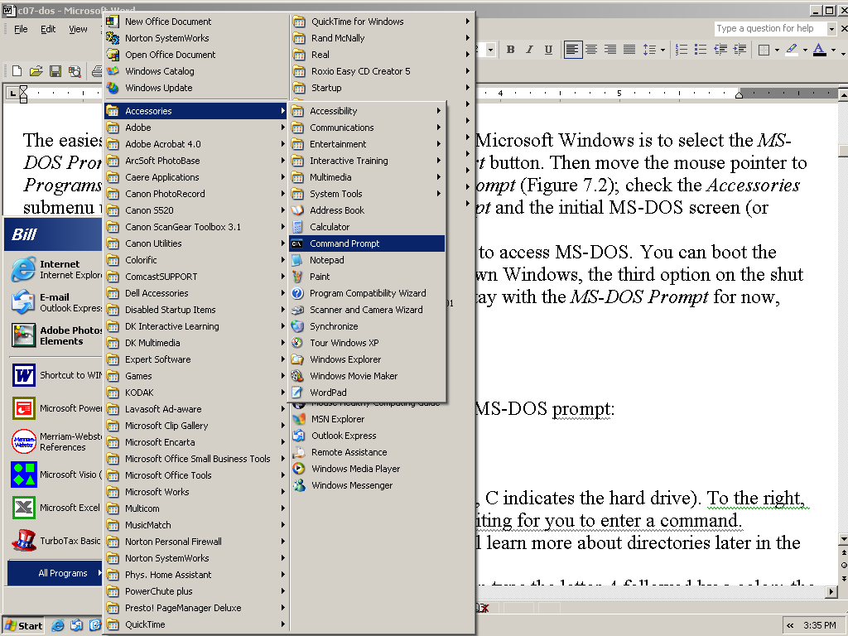
Figure 7.3 Accessing the command prompt through the Windows Start menu.

Slide 5
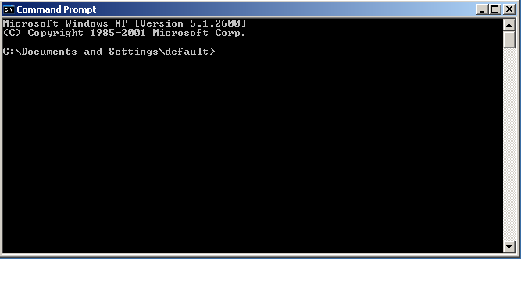
Figure 7.4 The initial MS-DOS prompt.

Slide 6

Figure 7.5 Changing the default drive to A.

Slide 7
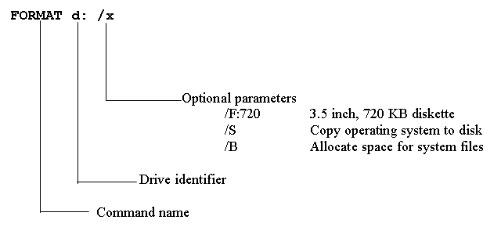
Figure 7.6 The FORMAT command.

Slide 8
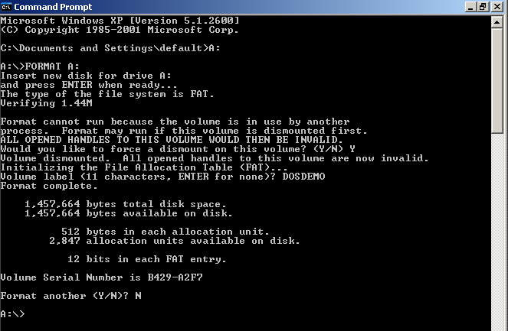
Figure 7.7 The FORMAT command guides you through the process of formatting a diskette.

Slide 9
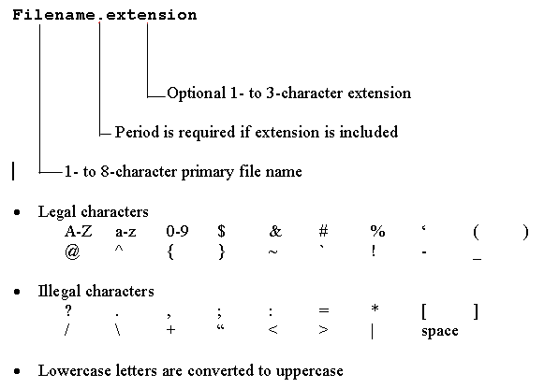
Figure 7.8 The rules for defining a file name.

Slide 10
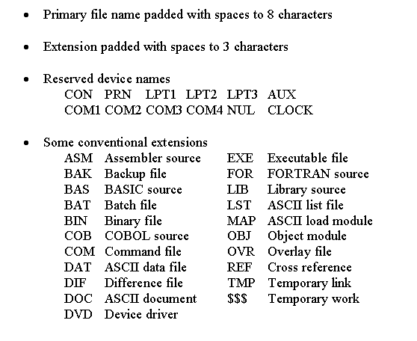
Figure 7.8, continued.

Slide 11
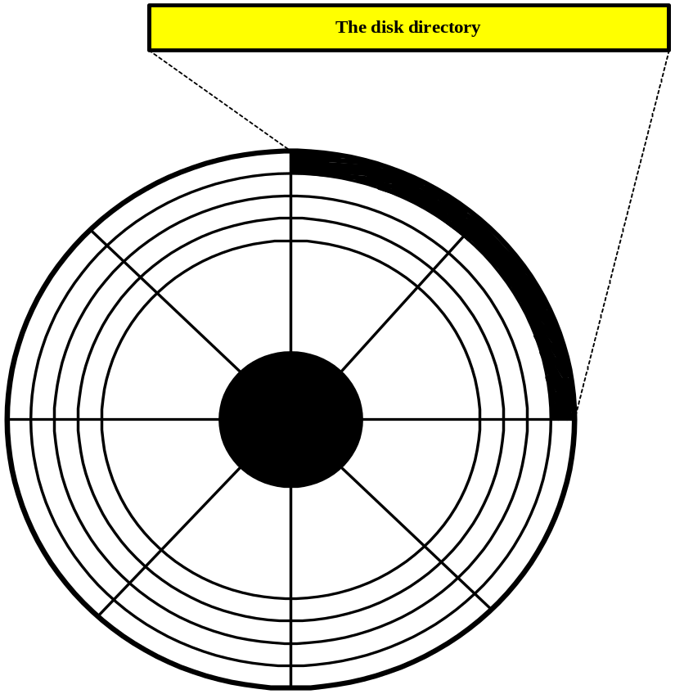
Figure 7.9 A file’s name and starting address are recorded in the disk directory.

Slide 12
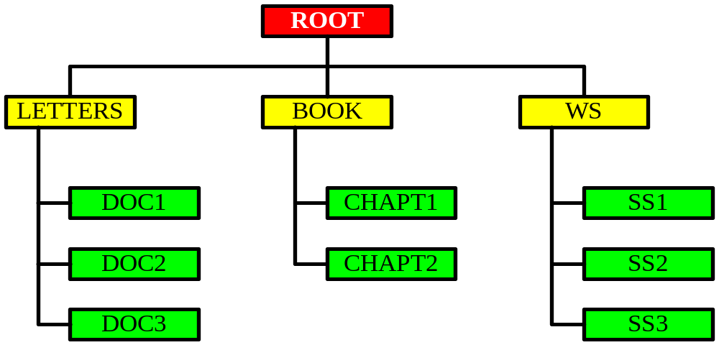
Figure 7.10 Subdirectories help to organize the data stored on a disk.
PAY
PAY

Slide 13
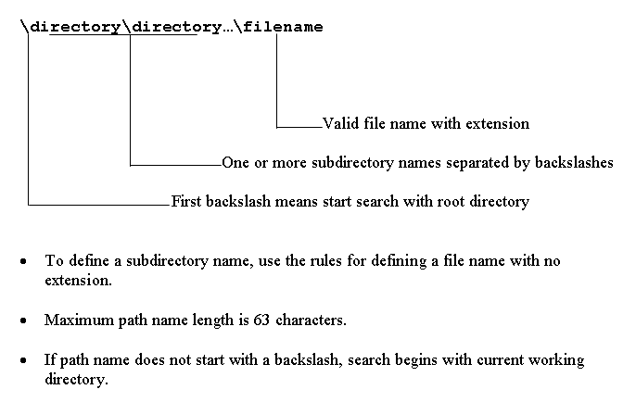
Figure 7.11 The rules for defining a path name.

Slide 14
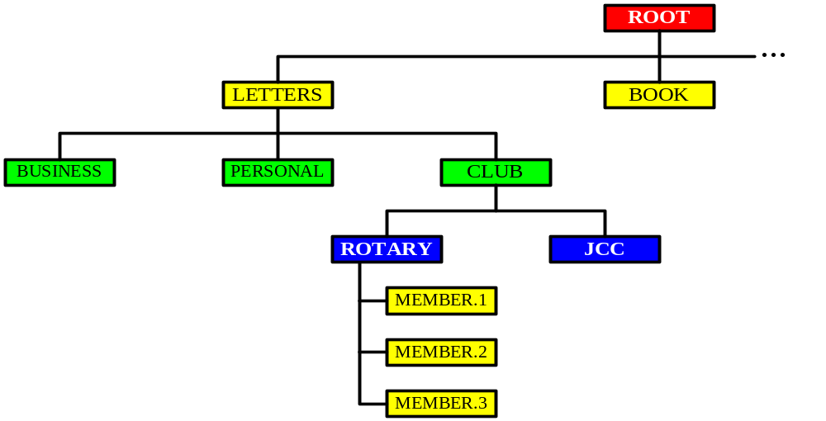
Figure 7.12 Directories can be subdivided into lower-level subdirectories.

Slide 15
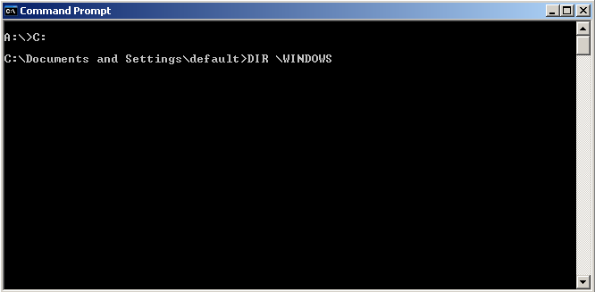
Figure 7.13 Make the C drive your default drive.

Slide 16
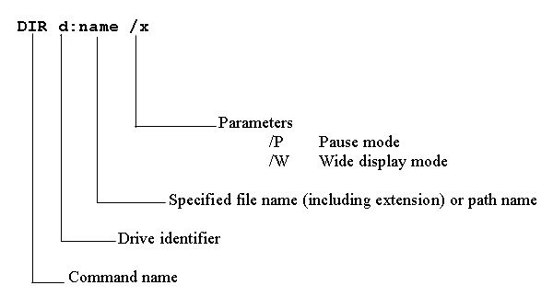
Figure 7.14 The directory (DIR) command displays a directory’s contents.

Slide 17
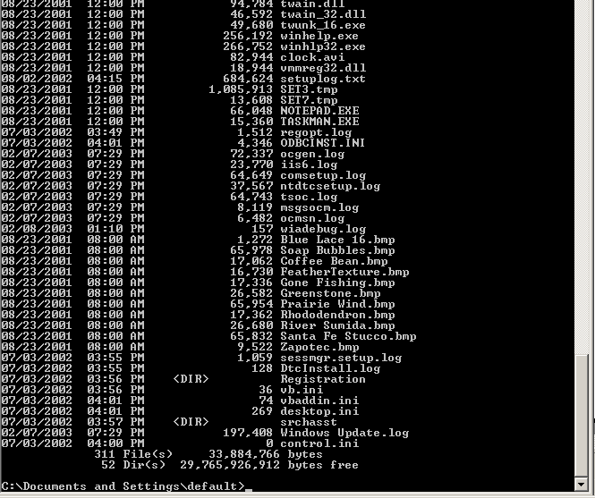
Figure 7.15 A directory list.

Slide 18
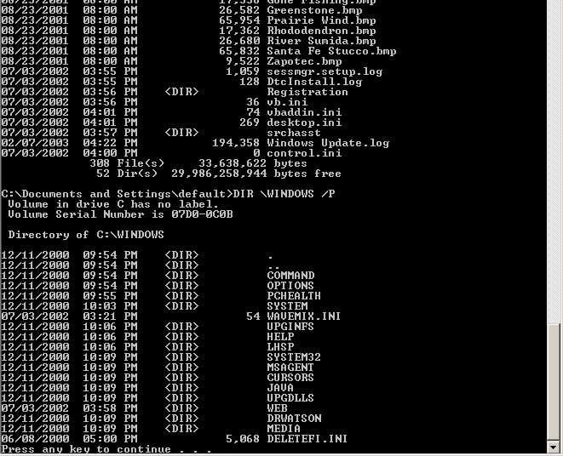
Figure 7.16 A directory command with a pause option.

Slide 19
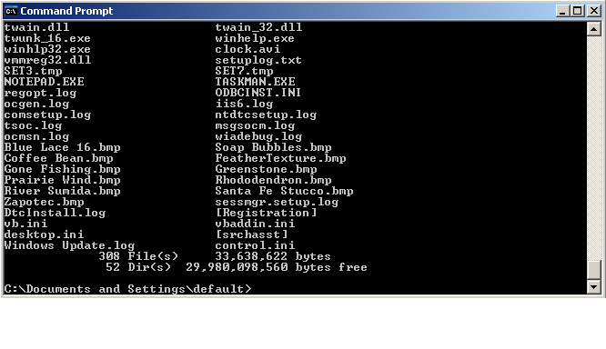
Figure 7.17 A wide mode directory list.

Slide 20
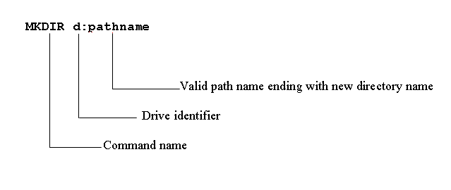
Figure 7.18 The make directory (MKDIR) command creates a new directory.

Slide 21
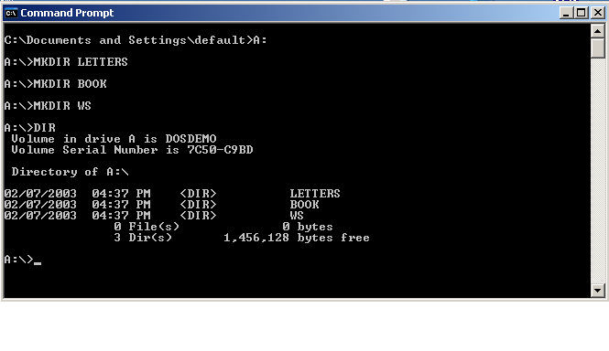
Figure 7.19 the commands to create and list three subdirectories.

Slide 22
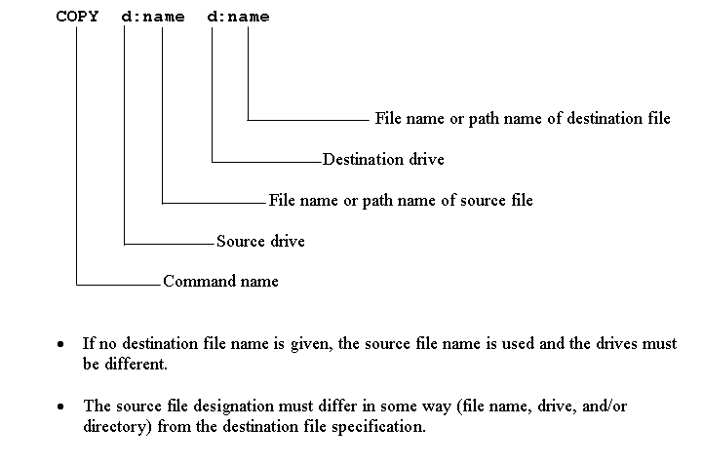
Figure 7.20 The COPY command copies one or more files.

Slide 23
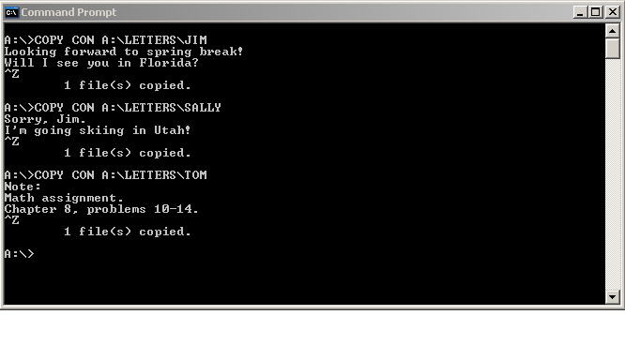
Figure 7.21 Copy these three files from the console to directory LETTERS.

Slide 24
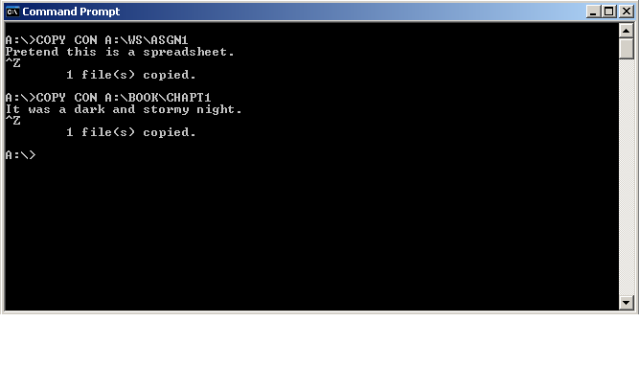
Figure 7.22 Copy this spreadsheet to WS and this opening sentence to BOOK.

Slide 25
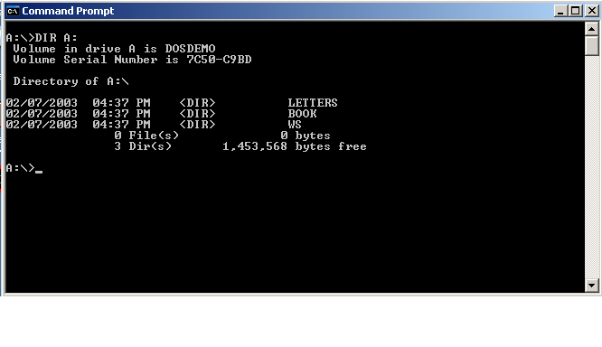
Figure 7.23 Your diskette’s root directory.

Slide 26
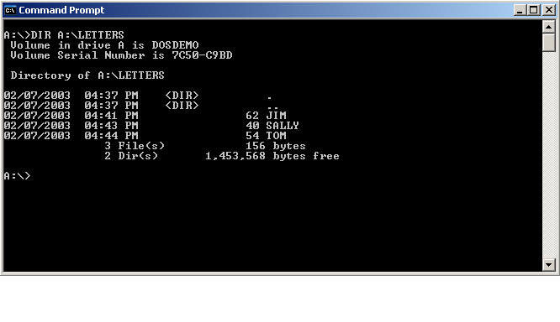
Figure 7.24 The contents of subdirectory LETTERS.

Slide 27
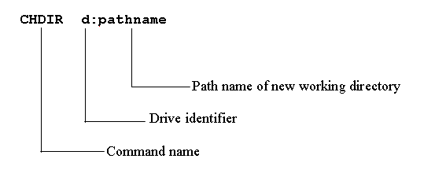
Figure 7.25 Use a change directory command to change the working directory.

Slide 28
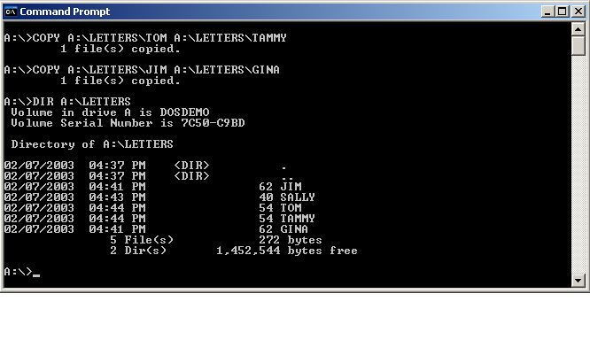
Figure 7.26 Some copy commands.

Slide 29
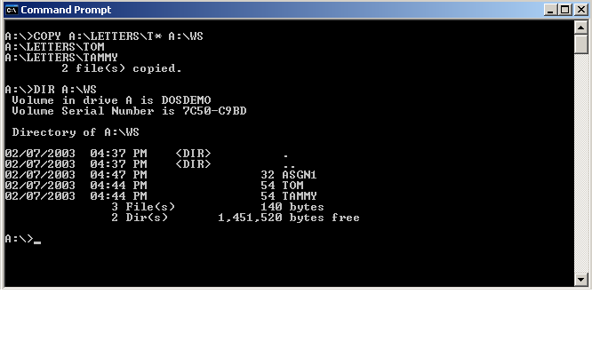
Figure 7.27 This copy command uses wild card characters.

Slide 30
Wild Card Characters
? (question mark)
  a single character
* (asterisk)
  one or more (usually more) characters

Slide 31
Pipes, Filters, and Redirection
Redirection
  Dynamically changing the default input or output device
Filter
  A command that reads the standard input device, filters (or modifies) the data, and writes to the standard output device.
Pipe
  An operator that causes one command’s standard output to be used as the standard input to another command.

Slide 32
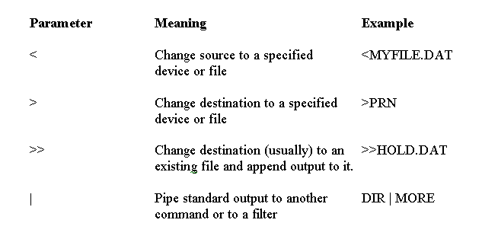
Figure 7.28 Redirection parameters allow a user to change the standard input and output devices to a specified file or device.

Slide 33
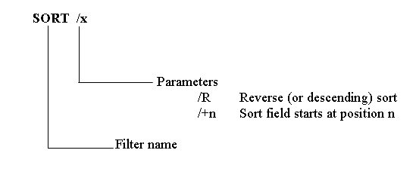
Figure 7.29 The SORT filter.

Slide 34
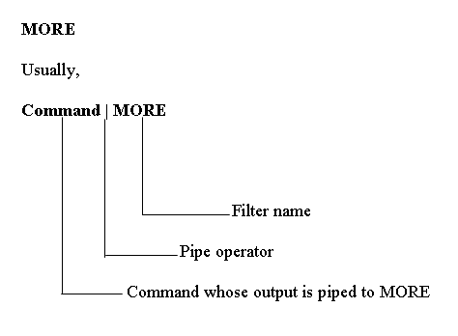
Figure 7.30 The MORE filter.

Slide 35
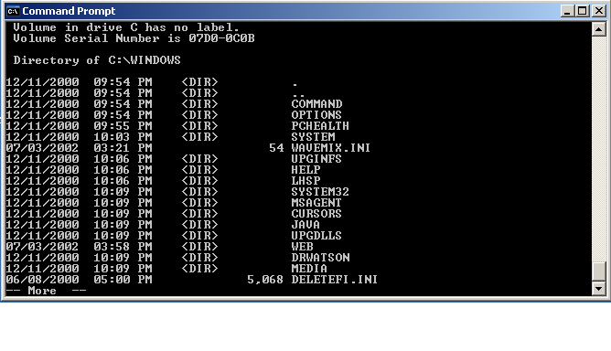
Figure 7.31 The MORE filter displays data one screen at a time.

Slide 36
Return to Windows
Type EXIT
Press enter

